Slide 1


Sports Analytics for Business Operations Module 3
Dr. Dave Schrader
Teaching Module For Teradata University Network
Send Questions or Comments to drdaveschrader@gmail.com

Slide 2
THIS IS MODULE 3
There are two versions of the materials
You can pull the “Overview Deck” which has all the slides in one place
Or – you can access 6 modules that carve the material up
#1 – Sports is Big Business
#2 – Sports Analytics is HOT
#3 – Sports Analytics for Business Operations
#4 – Sports Analytics for Team Operations
#5 – Sports Analytics for Training, Health, and Safety
#6 – How to Get a Job in Sports Analytics

Slide 3
Sports Analytics apply to
Business Operations – drive “customers”, make money!
Much of the work here is much like what’s happening in other industries like retail or telecommunications
Side note: most teams are Small and Medium Businesses. The amount of data is modest compared to what organizations like AT&T, Barclays Bank, Lufthansa use …
BUSINESS OPERATIONS
Topic 3
Notes:
Module 3 – Business Operations (PowerPoint)
Provided by Dr. Dave Schrader, drdaveschrader@gmail.com
Motivation: The purpose of this module is to show students that many of the uses of analytics for sports business operations are no different from the customer-focused activities in any other business. Replace “customer” by “fan”, “product” with “ticket”, and many of the issues and analytics techniques are the same!
The educational goals for this module include:
Students should be able to describe a variety of business operations uses of analytics.
Students should explore in more depth the examples from the Tom Davenport white paper in the business operations area.
Teaching NOTES on Pages of Module 3 (Page numbers refer to the master deck numbers; subtract 20 if you are looking at the subset, e.g., p. 23 in the 110 page master will be page 3 in the reduced deck. These notes are also in the Speaker Notes section on each slide.
This is the Introductory slide. Reiterate points from Module 2 about “who” comprise the business operations team – marketing, merchandising, sales, sponsorships, finance. Also people who monitor and try to influence social media, build up fan engagement through Facebook and Twitter, etc.

Slide 4
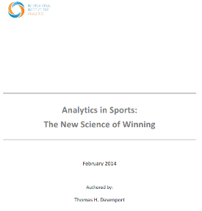

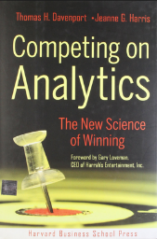
Great Source of Information
Thomas Davenport, “Analytics in Sports: The New Science of Winning”, International Institute for Analytics White paper, sponsored by SAS, Feb 2014.
Source: http://www.sas.com/content/dam/SAS/en_us/doc/whitepaper2/iia-analytics-in-sports-106993.pdf
Notes:
Students should already have read the Tom Davenport paper recommended in Module 2. If they have not done this, that’s OK, but almost all of the examples in this section come from that paper. Students should already have read the Tom Davenport paper recommended in Module 2. If they have not done this, that’s OK, but almost all of the examples in this section come from that paper. Students should already have read the Tom Davenport paper recommended in Module 2. If they have not done this, that’s OK, but almost all of the examples in this section come from that paper. Students should already have read the Tom Davenport paper recommended in Module 2. If they have not done this, that’s OK, but almost all of the examples in this section come from that paper.

Slide 5
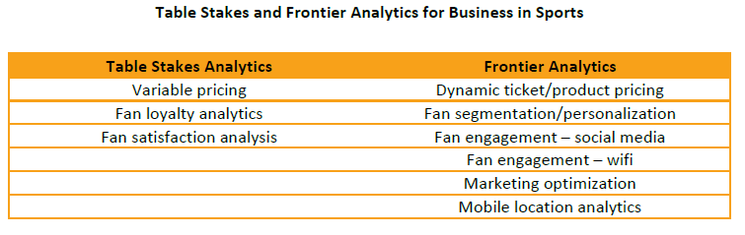
Business Operations Analytics What Do Most Teams Do? What’s Cutting Edge?
Thomas Davenport, “Analytics in Sports: The New Science of Winning”, International Institute for Analytics White paper, sponsored by SAS, Feb 2014.
Source: : http://www.sas.com/content/dam/SAS/en_us/doc/whitepaper2/iia-analytics-in-sports-106993.pdf
Notes:
This slide distinguishes between “Tables Stakes” – the things that almost all teams are already doing, and “Frontier” Analytics – which are the cutting edge topics. Note that some of what is labeled “Frontier” here would be considered “Table Stakes” in other industries. This can be a good discussion item with classes already familiar with the state of the art for customer relationship management.
These 2 terms come from the Tom Davenport paper.

Slide 6
Ticket Pricing – (Discussion)
What Factors Impact What Fans Will Pay?
Seat location (often called variable pricing)
Timing: 'last-second' / week-before purchases of tickets (often called dynamic pricing)
opponent rivalries,
weather prediction,
competing events,
weekday vs weekend,
game's time of day,
road construction surrounding stadium and on major roads leading to stadium,
team win/lose performance for the season,
recent win/loss record,
opponent record for season, etc.
Notes:
This slide can be used to get the students thinking about all the factors that might go into deciding ticket prices.
Begin this module with a brainstorming exercise. Students should think about ticket pricing, and what factors might cause a team to price tickets at variable price points. You may want to gther the inputs on a whiteboard and catalogue them – see next page notes on Variable vs. Dynamic Pricing.

Slide 7
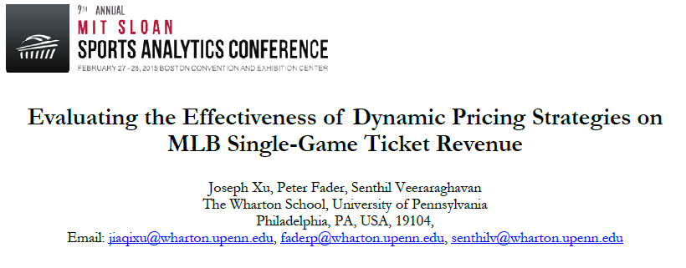
Pricing of Boston Red Sox Tickets
“Variable” pricing – by seat section (fixed price per section)
“Dynamic” pricing – seat prices can only go up as game day approaches
Experiment – half the season with one policy, half the other
Source: : http://www.sloansportsconference.com/wp-content/uploads/2015/02/SSAC15-RP-Finalist-Evaluating-the-effectivness-of-dynamic-pricing2.pdf
Notes:
The opening example is an experiment by the Boston Red Sox on dynamic pricing. Note that “Variable Pricing” is different from “Dynamic Pricing”. Variable pricing just means that there are different prices for different seating locations. Dynamic pricing is the idea of changing the price over time to match demand.
In this case, it was a constrained experiment to only increase (but never decrease prices). The team held ticket prices constant for games during the first half of the season. They then did dynamic pricing (but only increases of price, not decreases) for the last half of the season as an experiment. You might have a discussion about why they had this constraint (answer is that they did not want to annoy people who compared prices for tickets, to find out that had they waited they might have gotten a cheaper price). There are analogies here with the airline industry that you might want to point out. (Teradata has been used for years to do “revenue optimization”, meaning there are various “buckets” of fare classes and the price changes daily – or even every 15 minutes in the case of United Airlines, based on Teradata analytics of demand).
This provided a before/after comparison of a static vs. a monotonic increase in ticket prices. The authors built a model of what that did for overall revenue and found that the dynamic approach probably COST the ball team some money (<1%). They then did some models on other variations, including allowing decreases in prices. The abstract provides the results:
“The sports industry has seen a rapid adoption of dynamic pricing practices in recent years. However, there is still limited understanding on the effect of dynamic pricing on revenue in sport event settings and how to execute effective dynamic pricing strategies. In this paper, we address these issues by developing a comprehensive demand model for single-game ticket sales that can be used to predict the revenue associated with a particular pricing strategy over the course of a sport season. We apply the model to actual ticket sales and pricing data from an anonymous Major League Baseball franchise during a recent MLB season, and evaluate the effectiveness of the dynamic pricing policy applied by our partner franchise during that period. We find that the actual dynamic pricing strategy used by this franchise resulted in revenue decrease of 0.79% compared to a pricing policy where prices are fixed over time. We propose alternative pricing policies to help improve revenue and find that an optimized dynamic pricing policy can improve revenue by 14.3% compared to a pricing policy where prices are fixed over time.”
You may want to assign students to go read the entire paper (citation at the bottom of the page).

Slide 8
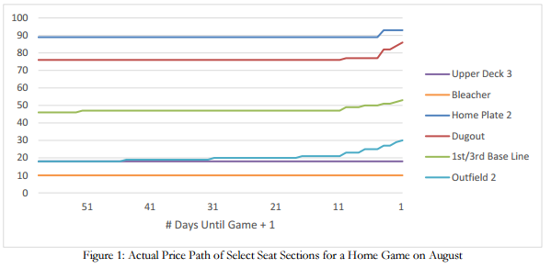
Red Sox Ticket Pricing Actual Dynamic Pricing for a Game in August
Source: : http://www.sloansportsconference.com/wp-content/uploads/2015/02/SSAC15-RP-Finalist-Evaluating-the-effectivness-of-dynamic-pricing2.pdf
Notes:
Here you can see their experiment of increasing prices for each tier category of seat as the game approaches.
Not shown (but in the paper) are curves for allowing decreases in prices – take a look!

Slide 9

CRM for Baseball Teradata Customer!
“Most teams do very simple CRM. One size fits all offers.
One exception is Major League Baseball Advanced Media (MLBAM), which has digital content of several types and does some personalization of ads and content based on inferred or furnished fan information.
MLBAM has been employing statistical tools for over a decade to understand its fans, and has more recently adopted programmatic marketing tools using analytics to place digital ads. It is widely viewed as being the most sophisticated media organizations in professional sports.”
Source: Thomas Davenport, “Analytics in Sports: The New Science of Winning”, International Institute for Analytics White paper, sponsored by SAS, Feb 2014.
Source: : http://www.sas.com/content/dam/SAS/en_us/doc/whitepaper2/iia-analytics-in-sports-106993.pdf
Notes:
MLB (Major League Baseball), unlike many other leagues, provides a central server for the hosting of all the team’s web sites. They also have a core analytics team that works with all the pro baseball teams to help increase their fan engagement and facilitate best practices. Importantly, they are also a Teradata customer! (I’m going to try to get more case studies from them in the near future). You could have a discussion on this slide of the value of centralized hosting vs. each team having its own web site group.

Slide 10

Season Ticket Sales - Attrition
“In season ticket sales, the Orlando Magic in the NBA pays special attention to fans identified (through a scoring model) as likely to attrit. The Magic, for example, creates:
…decision tree models that bucket subscribers into three categories: most likely to renew, least likely and fence sitters. The fence sitters then get the customer service department's attention come renewal time.”
Source: Thomas Davenport, “Analytics in Sports: The New Science of Winning”, International Institute for Analytics White paper, sponsored by SAS, Feb 2014.
Source: : http://www.sas.com/content/dam/SAS/en_us/doc/whitepaper2/iia-analytics-in-sports-106993.pdf
Notes:
This is a classic example from the Orlando Magic basketball team of building attrition predictive models to segment customers. You can ask what factors the students think might be important model factors. Note that this drives differentiated treatments and differentiated marketing spending to maximize season ticket sales.

Slide 11

Season Ticket Sales - Renewals
“The New England Patriots use an approach to season ticketholder retention that is based on a variety of behavioral metrics.
Their models include such variables as game attendance, purchases of team merchandise, attendance at special season ticketholder events, and attendance at concerts or soccer games at Gillette Stadium.
The Patriots also explore which channels in what sequence are best to communicate with season ticketholders.
The Patriots began using the behavioral model in 2009, and it led to a record 97% renewal of season tickets for the 2010 season.”
Source: Thomas Davenport, “Analytics in Sports: The New Science of Winning”, International Institute for Analytics White paper, sponsored by SAS, Feb 2014.
Source: : http://www.sas.com/content/dam/SAS/en_us/doc/whitepaper2/iia-analytics-in-sports-106993.pdf
Notes:
this example from the New England Patriot football team that provides some answers that students should have guessed on the previous example. Since the Patriots have a huge fan base and often sell out their games, it’s probably less important that they focus on retention than many teams!

Slide 12
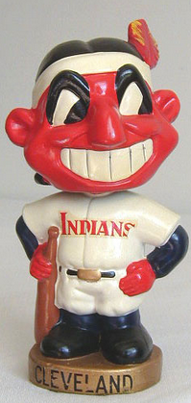
Marketing Mix Analytics – Cleveland Indians
“The Cleveland Indians are doing optimization of marketing programs and budgets—sometimes called marketing mix models.
One of the most difficult aspects of marketing optimization is to gather all the relevant data. The Indians, for example, gathered data on PR impressions, traditional and digital media spending, and game-day promotions, all in order to correlate the data with sales for particular games.
They concluded, among other results, that there should be fewer bobbleheads distributed at fewer games for optimal ticket lift from their marketing spending.”
Source: Thomas Davenport, “Analytics in Sports: The New Science of Winning”, International Institute for Analytics White paper, sponsored by SAS, Feb 2014.
Source: : http://www.sas.com/content/dam/SAS/en_us/doc/whitepaper2/iia-analytics-in-sports-106993.pdf
Notes:
This example from the Cleveland Indians baseball team is interesting, and focuses on the topic of marketing mix: how many dollars to invest in any of the hundreds of options for attracting, growing, and retaining customers. Bobbleheads are collectibles and you might think that this could cause more share of wallet as collectors attend more games. But it seems to have backfired. Why could this have happened? (I will work to find out the answer!)

Slide 13

Fan Behavior Before/After Game Phoenix Suns and Verizon Wireless
“Where fans attending the team’s games live (and hence where people live who don’t attend games) in order to target team advertising
How many fans at games are from out of town (about 22% in one month studied)
The attributes of fans who attend games (between 25 and 54, with household incomes of more than $50,000, parents with children at home)
How often game attendees also attend baseball spring training games in the Phoenix area (13%)
Increases in traffic at a fast food chain within 24 hours of a game that are linked to a Suns promotion (8.4%)”
Source: Thomas Davenport, “Analytics in Sports: The New Science of Winning”, International Institute for Analytics White paper, sponsored by SAS, Feb 2014.
Source: : http://www.sas.com/content/dam/SAS/en_us/doc/whitepaper2/iia-analytics-in-sports-106993.pdf
Notes:
you can have some fun with this one. It touches on the hot marketing area of “location analytics”. Since almost everyone carries of mobile phone, it’s possible with the right apps to monitor people’s locations – both before and after games. The examples given here give rise to open questions about privacy, however, so you can have a nice little side conversation on whether doing these kind of marketing activities are a good or bad thing. For each example insight, you might ask “how do they use this insight”, or even give this as a homework assignment.

Slide 14
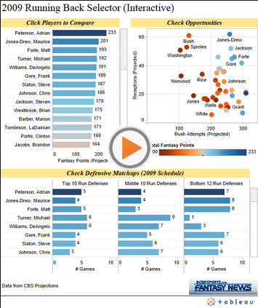
Sports Finance
Staying within the salary cap – an optimization problem
Who to acquire, and at what cost? Equity issues for existing players
Visualization helps – try from out this running back selector from Tableau, a Teradata Partner
Fantasy Sports!
Source: https://public.tableau.com/s/gallery/fantasy-football-2009-season-running-backs
Notes:
See also Source: http://www.tableau.com/blog/using-tableau-most-important-decision-fantaasy-footballer-can-make
I’m putting the Finance function into the Front Office Apps section. Like any business, there are HR problems of what talent to acquire and how much to pay. There are differences – the salaries are usually very public and can give rise to salary payment mismatches among team members. But salary compression can be an issue for companies, too. Note that this is an interesting optimization problem, especially when leagues have salary caps on the total amount of spending. You might do some research on the favorite teams in your area and have a side discussion on how they should optimize their spend, e.g., in football, would it be better to pay more to replace an aging quarterback than to hire a rookie who is the fastest receiver? Also, a good side discussion here is about fantasy football, since now fans have to make decisions about how to best build “their team”. You could have students who are Fantasy fans describe the analytics they use to make their decisions (if they use any!) The example from Tableau is meant to show how a large amount of information useful to making these decisions can be shown on one screen, and how you can compare the current crop of new hiring opportunities against past draft players (and how they worked out). The general problem here is how to build better predictive models, finding factors that give you a competitive edge over the other teams.

Slide 15
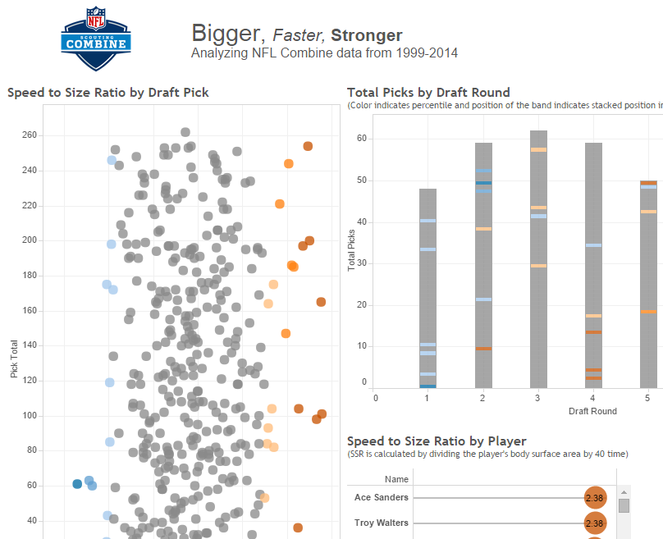
Player Draft
The NFL Combine is an event where college football players who hope to be selected for pro teams are put through a series of drills, and measured
Tableau can be used to visualize the data quickly
Source: http://www.tableau.com/solutions/sports-management
Notes:
another Tableau example, from the NFL Football Combine, which is a summer camp where college athletes are run through a variety of standardized drills and measured. There can be different drills for different skill positions. For example, explosiveness off the line for a big lineman who is blocking defenders is far more important than how fast he can run a 40 yard dash. You can ask a student who watched the latest drafts to comment on this slide.

Slide 16
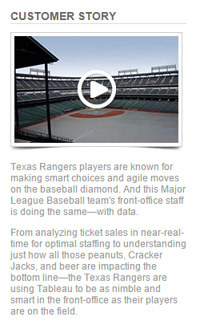
Front Office Analytics at the Texas Rangers
Created an Analytics Task Force to gather all relevant customer data into one place
Used Tableau visualizations to get a variety of new insights
See a PPT deck on Slideshare at
http://www.slideshare.net/Jingcong/how-texas-rangers
Play 2min11sec Video at
http://www.tableau.com/solutions/sports-management
Notes:
if you want to spice things up with a longer PPT deck from the front office group (only 4 people in their analytics team) from the Texas Rangers baseball team, you might want to show the video (only 2 minutes) and take a look at their presentation on Slideshare.

Slide 17
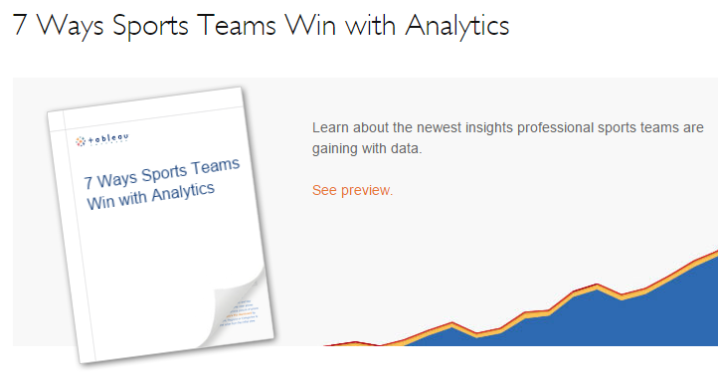
New White Paper on Sports Visualization
Source: http://www.tableau.com/learn/whitepapers/7-ways-sports-teams-win-analytics
Notes:
Tableau is a Teradata (and TUN) partner. They have launched a sports analytics focus area, and recently published this white paper, so you may want to give reading this as a homework assignment.
Summary: the area of Business Operations analytics include fan relationship building via acquisition, growth, and retention campaigns (just like CRM), ticket pricing, and HR topics like player cost management. Many of the types of analytics in this section have direct analogues in the traditional business world of large enterprises that are Teradata customers.

